Slide 1
AI Authorship Attribution
Sam McDowell
LU Honors Petition
Fall 2025

Slide 2
The Problem
Authorship is no longer obvious

Slide 3
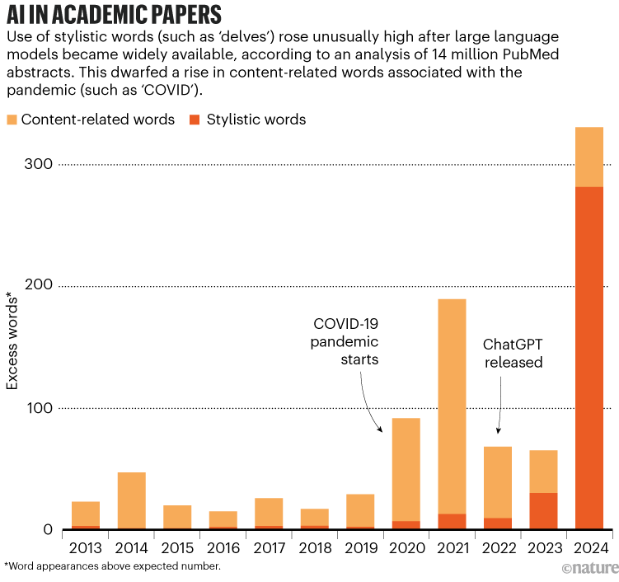
AI is being used a lot
Notes:
https://www.nature.com/articles/d41586-024-02371-z

Slide 4
The Solution
Subtitle

Slide 5
Authorship Attribution
Stylometry: the use of statistical methods to analyze linguistic style

Slide 6
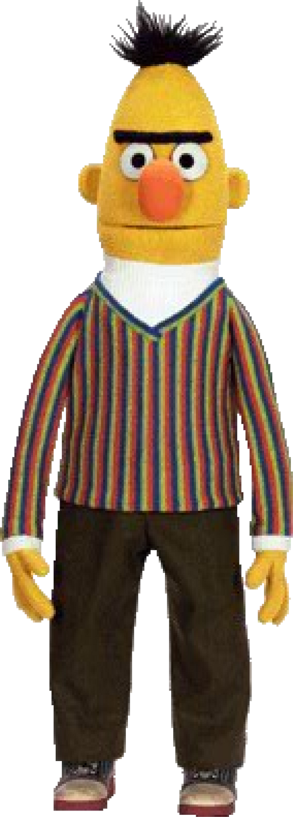




5 Approaches
BERT Model
Embedding Centroid Attribution
KNN Clustering
Random Forest Classification
Neural Network

Slide 7
Dataset Features
Vocabulary
  Type Token Ratio (unique/total words)
  Stop Word Ratio (stop/total words)
  Hapax Legomena (count words used only once)

Slide 8
Dataset Features
Readability
  Avg Syllable Count
  Avg Word/Sentence Length
  Flesch Readability Score
  Dale-Chall Grade Level
  Gunning Fog Index

Slide 9
Dataset Features
Tagging
  POS Counts
  Punctuation Counts
  Sentence Structure Counts

Slide 10
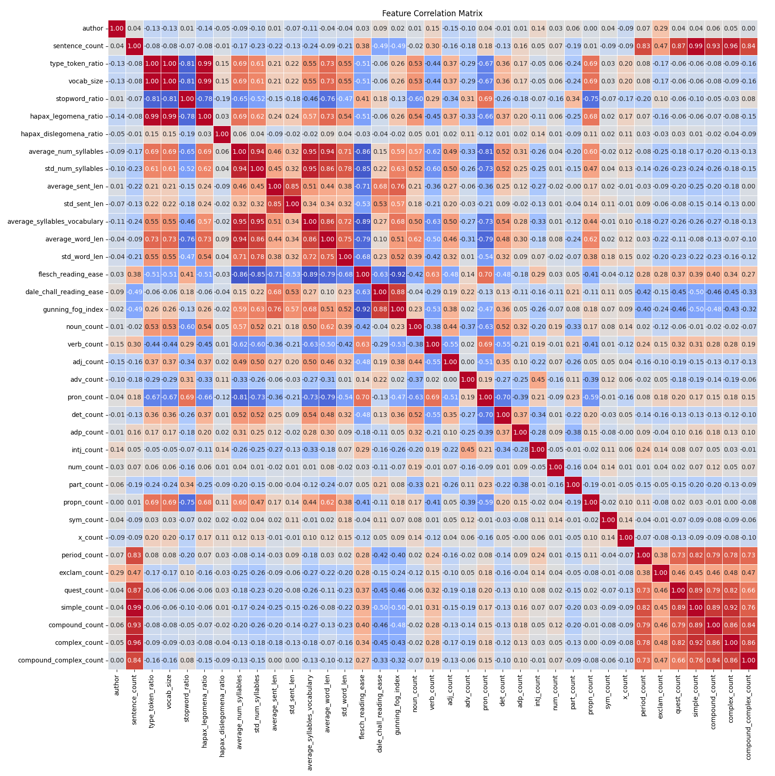

Slide 11
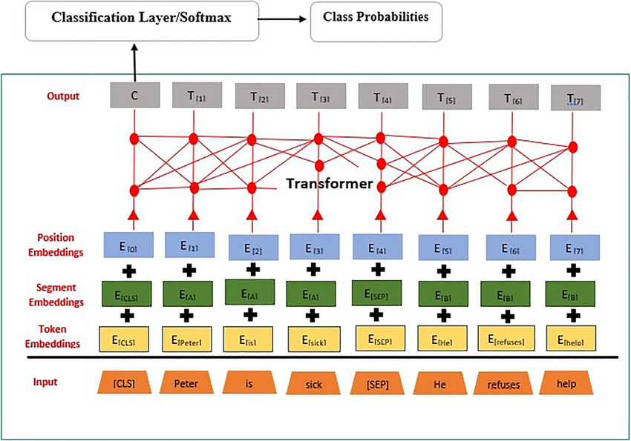
BERT

Slide 12
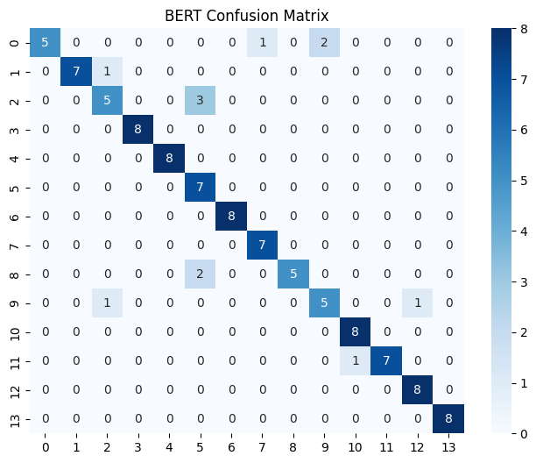
BERT
Accuracy: 87%
F1: 87%

Slide 13

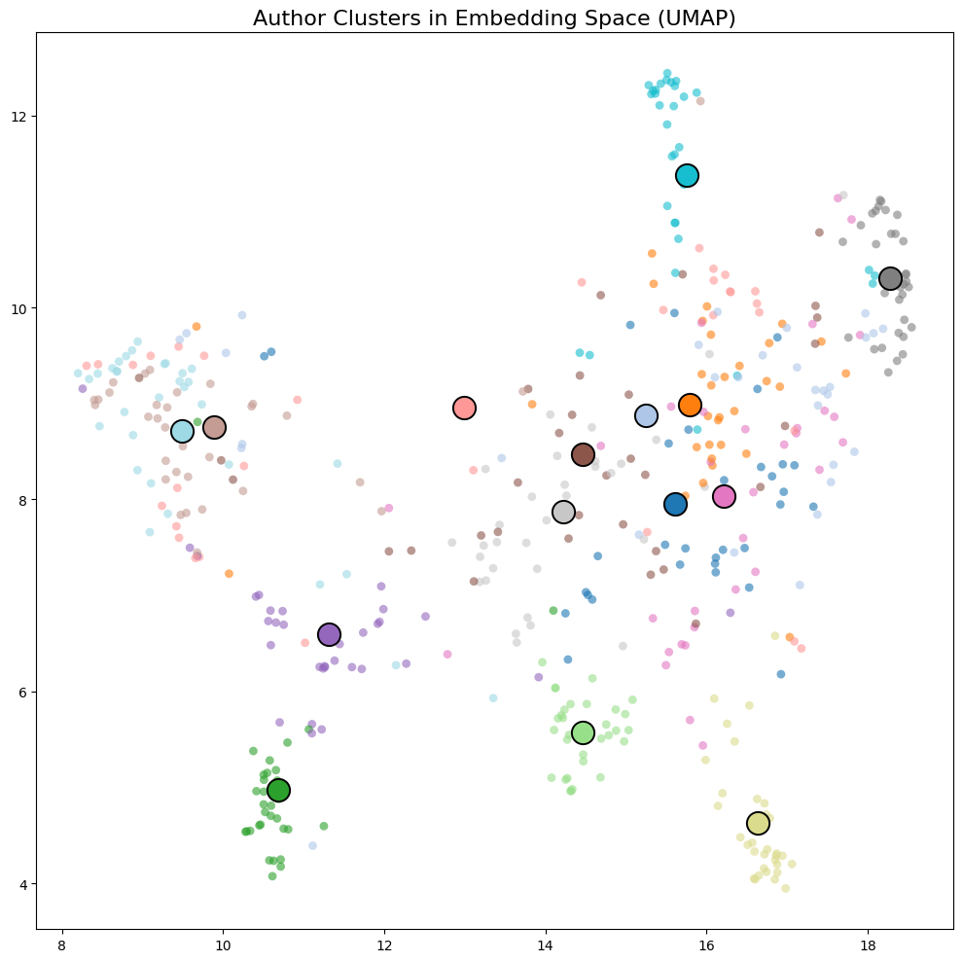
Embedding Centroid

Slide 14

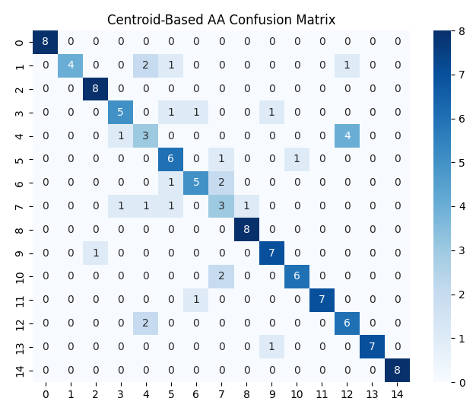
Embedding Centroid
Accuracy: 76%
F1: 71%

Slide 15

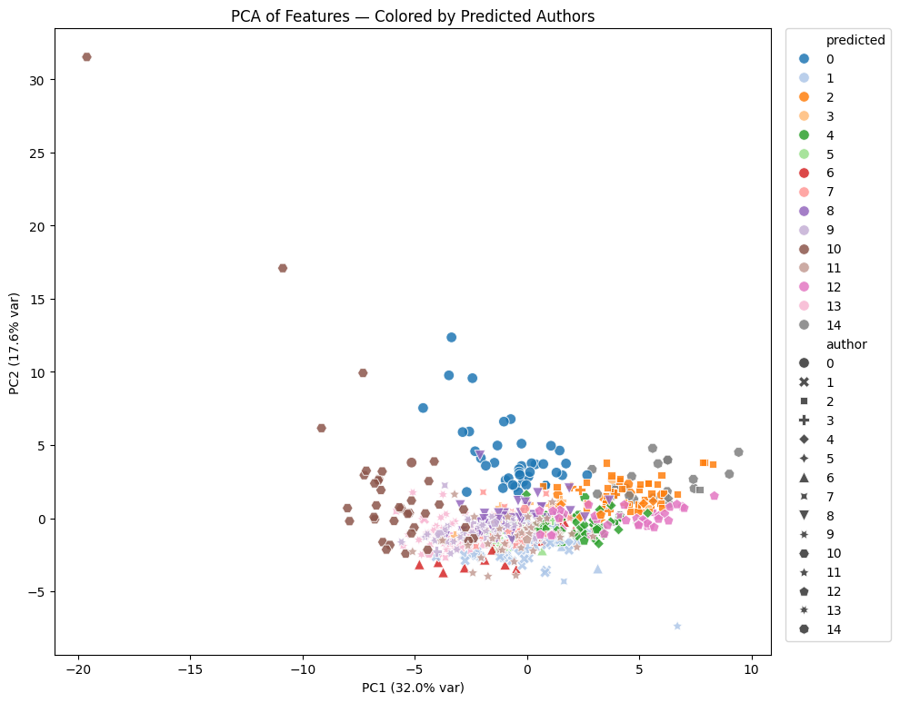
KNN

Slide 16
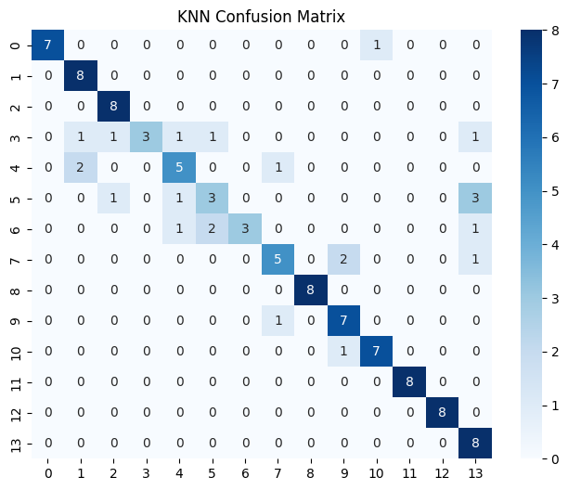
KNN
Accuracy: 75%
F1: 73%

Slide 17

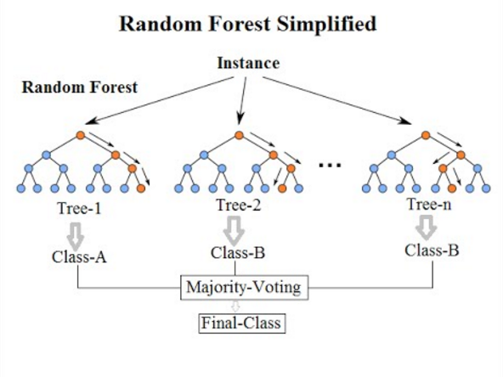
Random Forest

Slide 18
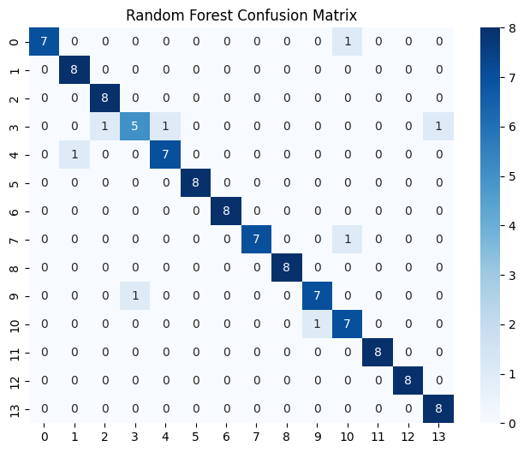
Random Forest
Accuracy: 92%
F1: 91%

Slide 19

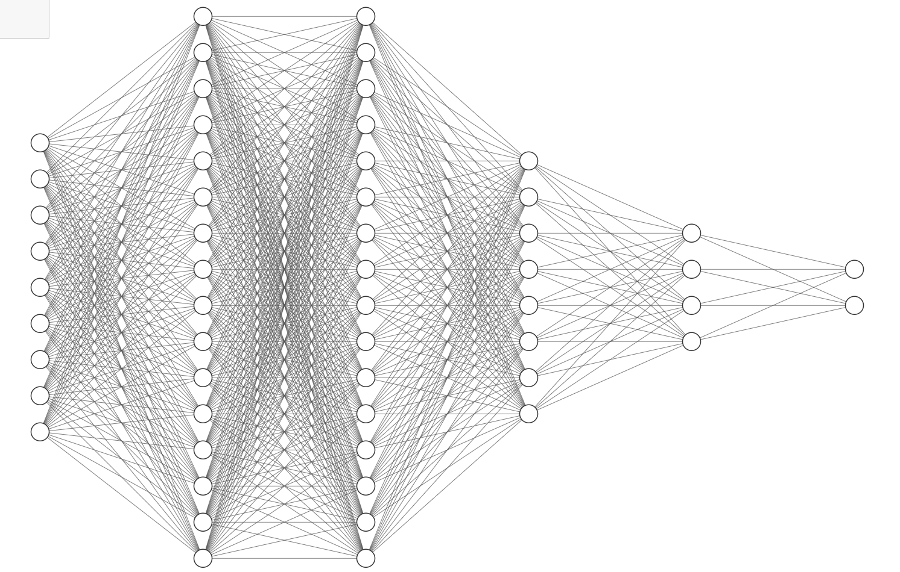
Neural Network
37 Input
256
256
128
64
15 classes

Slide 20
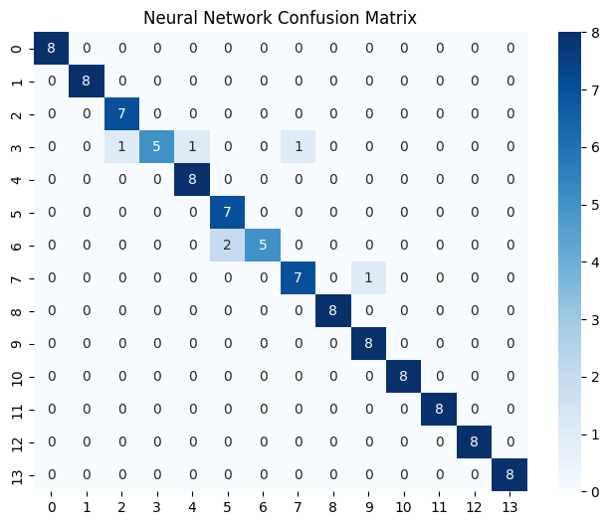
Neural Network
Accuracy: 92%
F1: 91%

Slide 21
Where to go from here
Thesis Topic
Industry Opportunities
Explore the extent of LLMs ability to mimic writing style through stylometry and authorship attribution.
Improve AI detection systems
Security (misinformation, impersonation)
Forensics

Slide 22
Thank You

